Slide 1




NEXT GEN EMPLOYABILITY PROGRAM
Creating a future-ready workforce
Team Members
College Name
Student Name :KEERTHANA.M
Student ID :au112021104014
Jaya sakthi engineering college

Slide 2

CAPSTONE PROJECT SHOWCASE
Project Title
MUSIC WEB APPLICATION USING DJANGO FRAMEWORK
Abstract | Problem Statement | Project Overview | Proposed Solution | Technology Used | Modelling & Results | Conclusion

Slide 3
Abstract:
The rise of digital technology has transformed the music industry, providing new opportunities for artists, producers, and music enthusiasts to connect and engage. In this era of digital music consumption, there is a growing demand for innovative platforms that offer seamless music streaming, personalized recommendations, and social interaction.
The Django framework will be leveraged for backend development, providing a robust and scalable foundation for the application. Frontend development will be accomplished using HTML, CSS, and JavaScript, with additional libraries and frameworks as needed.
The music web application developed using the Django framework will offer a modern and feature-rich platform for music enthusiasts to explore, discover, and enjoy their favorite music content.
Source :

Slide 4
Problem Statement:
Content Management: Managing a vast catalog of music content, including songs, albums, artists, genres, and playlists, poses challenges in terms of content organization, metadata management, and content moderation
Technical Complexity: Developing a music web application involves complex technical requirements, including user authentication, media streaming, database management, and integration with external APIs for music metadata and recommendations.
Social Interaction: Facilitating social interaction and community engagement within the music application requires features such as user profiles, social sharing, comments, likes, and follower/following relationships.
Copyright Issues: Addressing legal and copyright concerns related to music licensing, intellectual property rights, and digital rights management (DRM) is essential for compliance with copyright laws and regulations.
Source :

Slide 5
Project Overview:
Create a User-Friendly Interface: Develop an intuitive and user-friendly interface for music playback, playlist management, and music discovery, ensuring compatibility across various devices and screen sizes.
Enable Music Streaming: Implement music streaming functionality to enable users to listen to music tracks in real-time, ensuring smooth playback and high-quality audio streaming.
Enable Social Interaction: Implement social features such as user profiles, social sharing, comments, likes, and follower/following relationships to foster community engagement and interaction within the music application.
Enhance User Experience: Continuously iterate and improve the user experience based on user feedback and analytics data, incorporating usability enhancements, accessibility features, and design improvements.
Data Security and Privacy: Implement security measures to protect user data, prevent unauthorized access, and ensure compliance with data privacy regulations and industry standards.]
Source :

Slide 6
Proposed Solution:
The proposed solution for the Music Web Application Using Django Framework project involves leveraging the Django framework's robust features, scalability, and security to develop a comprehensive and feature-rich web application for music enthusiasts.
Key Components of the Proposed Solution:
1.User Authentication and Authorization:
Implement a secure user authentication and authorization system using Django's built-in authentication framework.
Manage user accounts, permissions, and access control to ensure data security and privacy.
2.Music Catalog Management:
Develop a robust catalog management system to organize music content, including songs, albums, artists, genres, and playlists.
Implement features for browsing, searching, and filtering music content based on various criteria.
.
Source :

Slide 7
3.Music Streaming Functionality:
Enable music streaming functionality to allow users to listen to music tracks in real-time.
Implement audio streaming protocols and codecs to ensure smooth playback and high-quality audio streaming.
4.Personalized Recommendations:
Integrate machine learning algorithms or recommendation systems to provide personalized music recommendations based on user preferences and listening history.
Analyze user behavior patterns and music preferences to generate relevant recommendations for each user.
5.Social Interaction Features:
Implement social features such as user profiles, social sharing, comments, likes, and follower/following relationships to foster community engagement and interaction.
Enable users to share music content, comment on tracks, like/dislike songs, and follow other users to discover new music and engage with the music community.
Source :

Slide 8
6.Performance Optimization:
Optimize the performance and scalability of the application to handle large volumes of concurrent user requests and high traffic loads.
Implement caching mechanisms, load balancing, and database optimization techniques to ensure optimal performance
Outcomes:
A fully functional and user-friendly music web application built using the Django framework.
Seamless music streaming, personalized recommendations, and social interaction features for users.
Enhanced data security, privacy, and compliance with regulatory requirements.
Improved performance, scalability, and reliability of the application.
Positive user feedback and engagement, leading to increased user satisfaction and retention.
.
Source :

Slide 9


Technology Used
Front-end
Back-end
Source :

Slide 10
Modelling & Results:
Modeling:
Define the database schema using Django models to represent entities such as users, songs, albums, artists, playlists, comments, likes, and follows.
Utilize Django's ORM (Object-Relational Mapping) to define relationships between entities, including one-to-many, many-to-many, and one-to-one relationships.
Results:
A fully functional music web application built using Django framework with features for music streaming, catalog management, user authentication, and social interaction.
Enhanced user engagement and satisfaction through personalized recommendations, social features, and seamless music playback.
Improved data security, privacy, and compliance with regulatory requirements.
Positive feedback from users, increased user retention, and growth in user base.
Source :

Slide 11
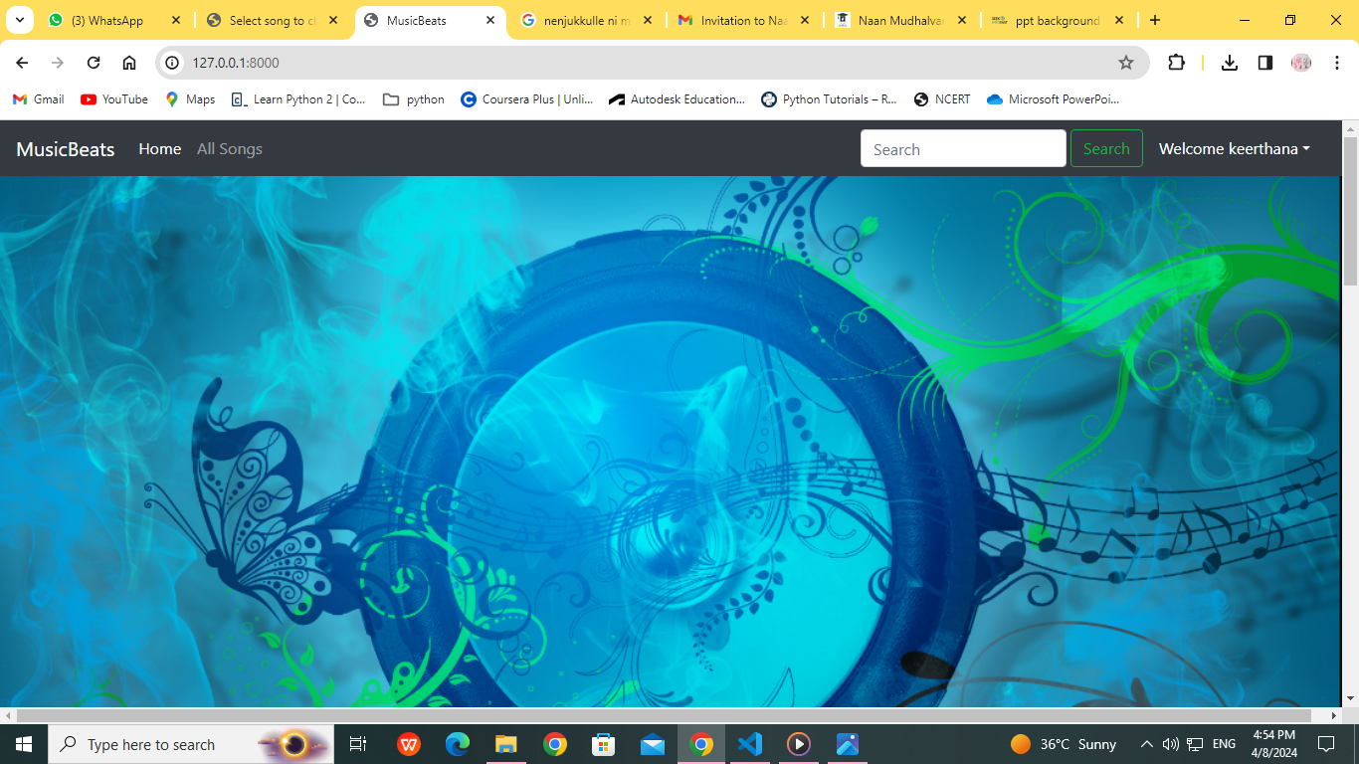
Homepage

Slide 12
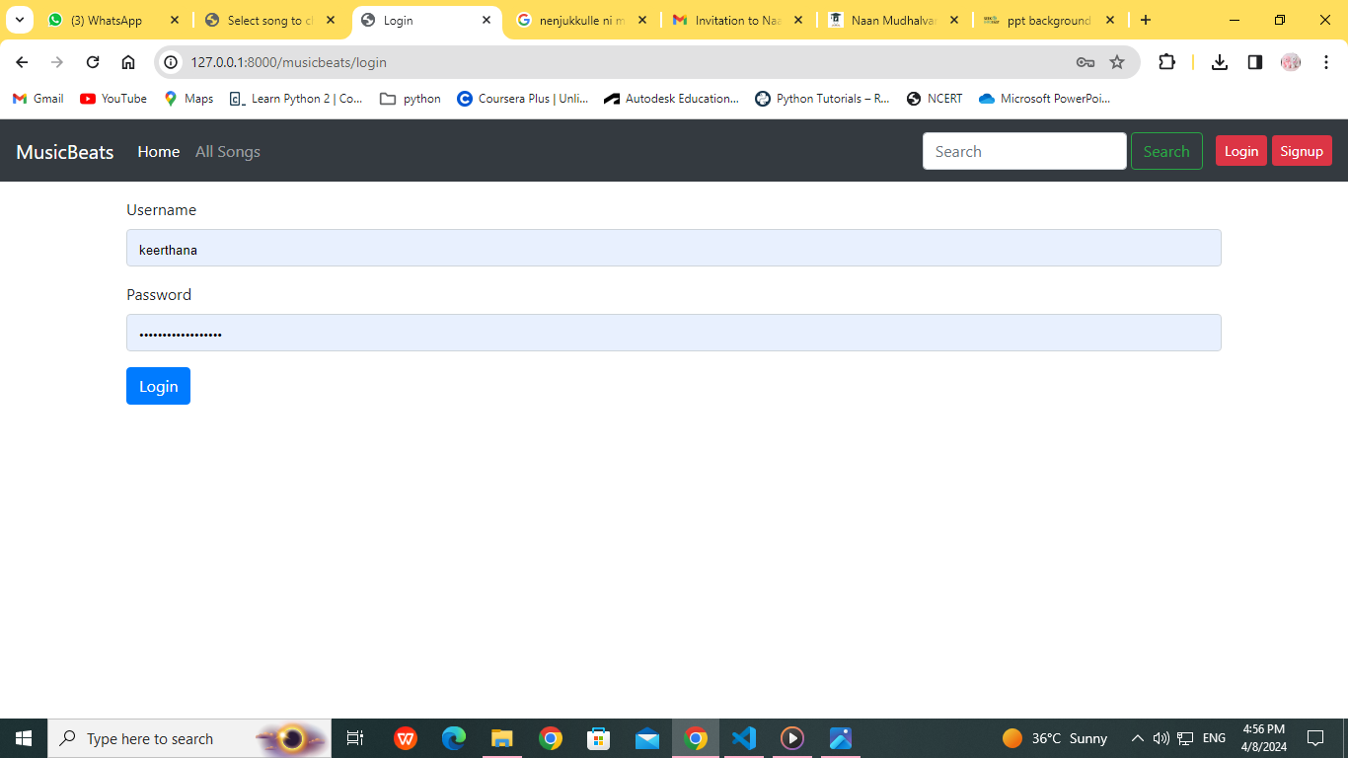
About-Us-Page

Slide 13
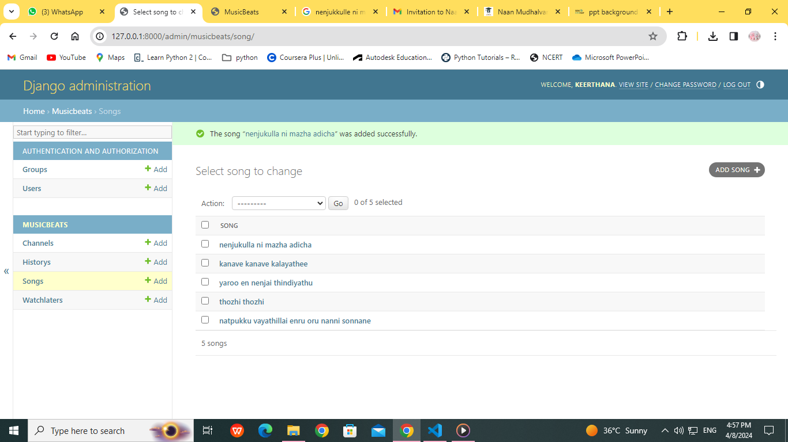
Service-Page

Slide 14
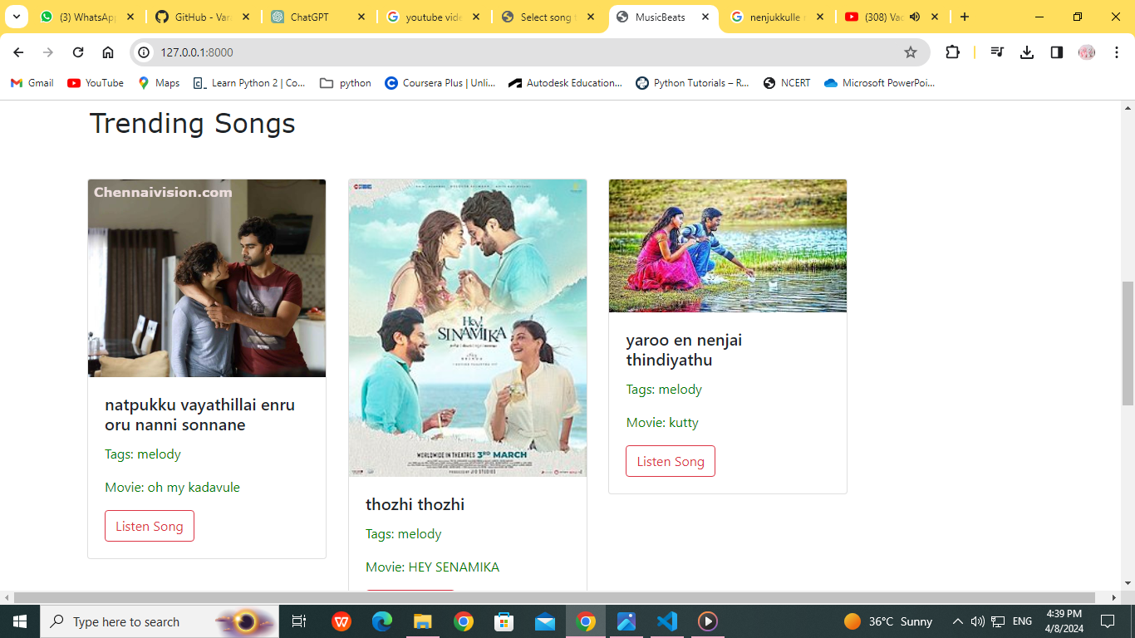
Departments-Page

Slide 15
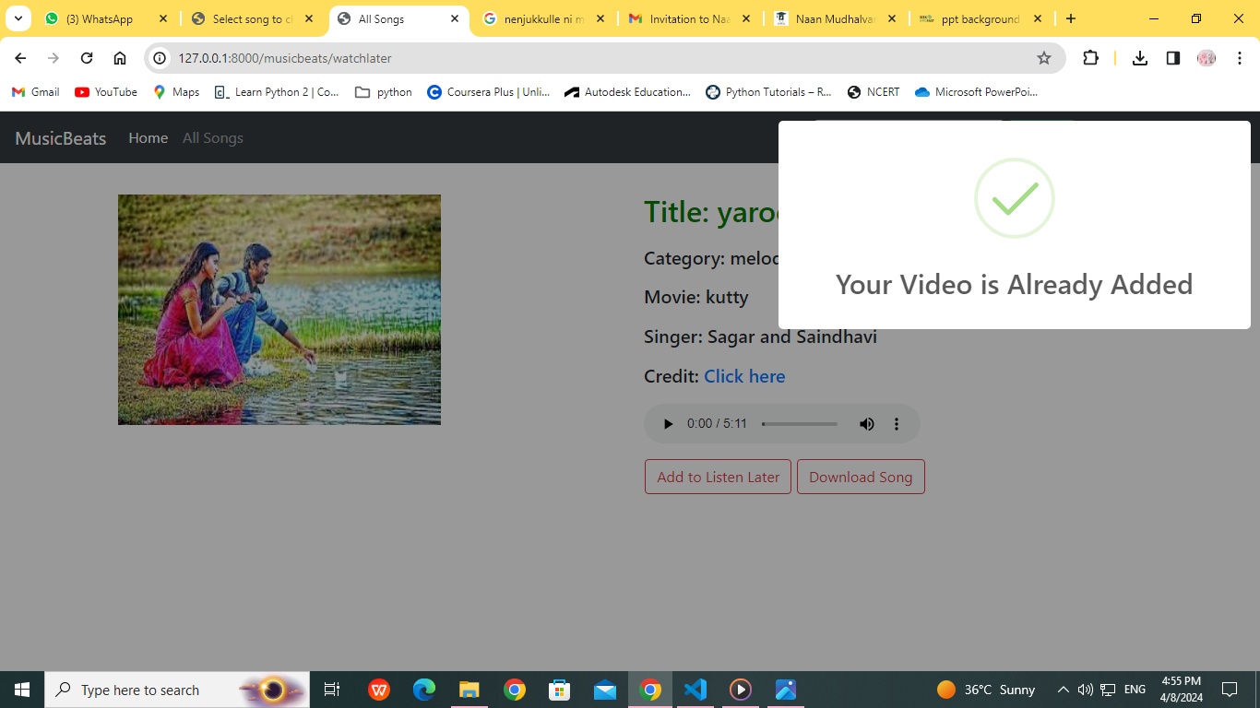
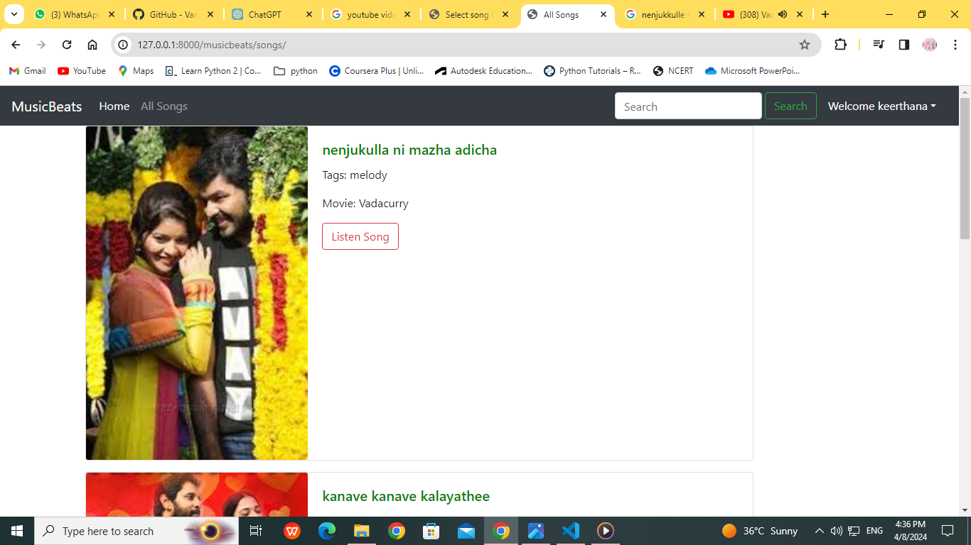
Blog-Page

Slide 16
Future Enhancements:
Live Streaming and Events: Integrate live streaming capabilities to broadcast live concerts, DJ sets, or music events directly within the application. Allow users to discover and attend virtual events, concerts, or live streams from their favorite artists or venues.
Enhanced Social Features: Enhance social interaction features by adding messaging functionality, allowing users to communicate and connect with each other within the app. Implement group chats, direct messaging, or community forums to facilitate discussions about music, concerts, and related topics.
Voice Assistant Integration: Integrate voice assistant capabilities, such as Amazon Alexa or Google Assistant, to enable hands-free control of the music app. Users can use voice commands to search for songs, play playlists, skip tracks, or control playback settings, enhancing accessibility and user convenience.

Slide 17
Conclusion:
The Music Web Application Using Django Framework serves as a testament to the power of Django in building sophisticated and feature-rich web applications.
With its robust architecture, extensive feature set, and potential for future growth, the application is well-positioned to meet the evolving needs and expectations of music enthusiasts in the digital age.
The Music Web Application offers a comprehensive set of features, including music catalog management, personalized recommendations, social interaction capabilities, and integration with external APIs. By implementing user authentication, authorization, and data security measures
future enhancements, including advanced recommendation algorithms, interactive music discovery features, and integration with emerging technologies such as augmented reality and voice assistants.
These enhancements will further enrich the user experience and keep the application at the forefront of innovation in the music industry.
Source :

Slide 18
Thank You!
Notes:
Thank You !!

